Slide 2
Michael Niehaus
Programme Director, 2Pint Software michaeln@2pintsoftware.com
2x ex-MVP
Ten(-ish) learnings from ten years of
Windows Autopilot

Slide 3
Quick history
2016
Mac@IBM announced at JAMF conference
Microsoft starts work on what will become Windows Autopilot
2017
First Windows Autopilot public release in Windows 10 1703
2018–2019
More features added (HAADJ, Self-Deploying, Pre-provisioning)
2020–2023
Nothing of significance
2024
Autopilot v2, a.k.a. Deployment Preparation, released
2026
10th anniversary of the start of work…

Slide 4
What have we learned in 10 years?
Autopilot is a great marketing success
There have been plenty of bumps and bruises along the way
There are always lots of “opportunities for improvement”

Slide 5
#1: Device registration is challenging

Slide 6
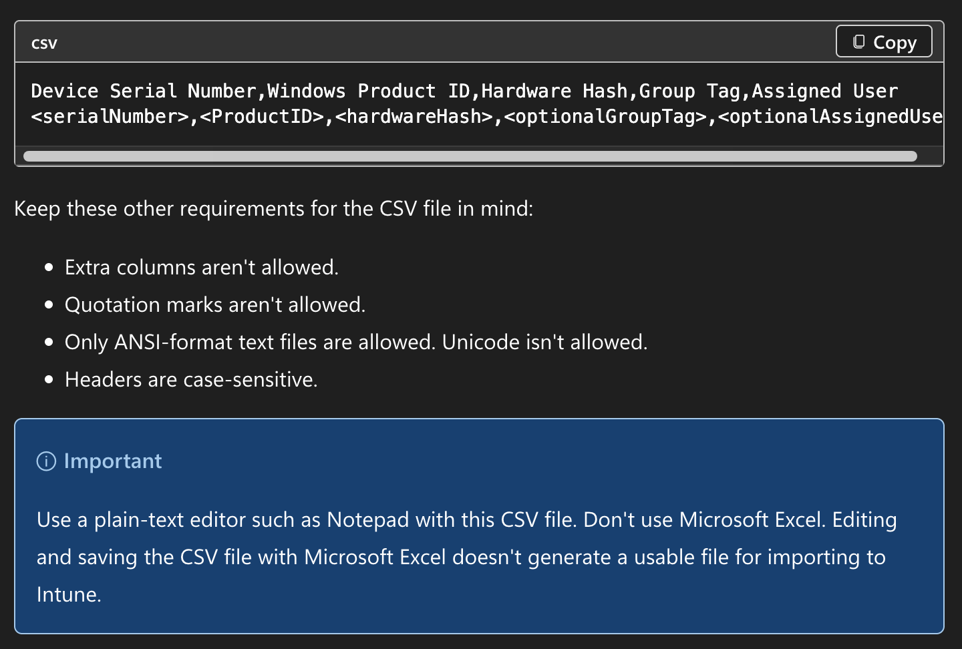
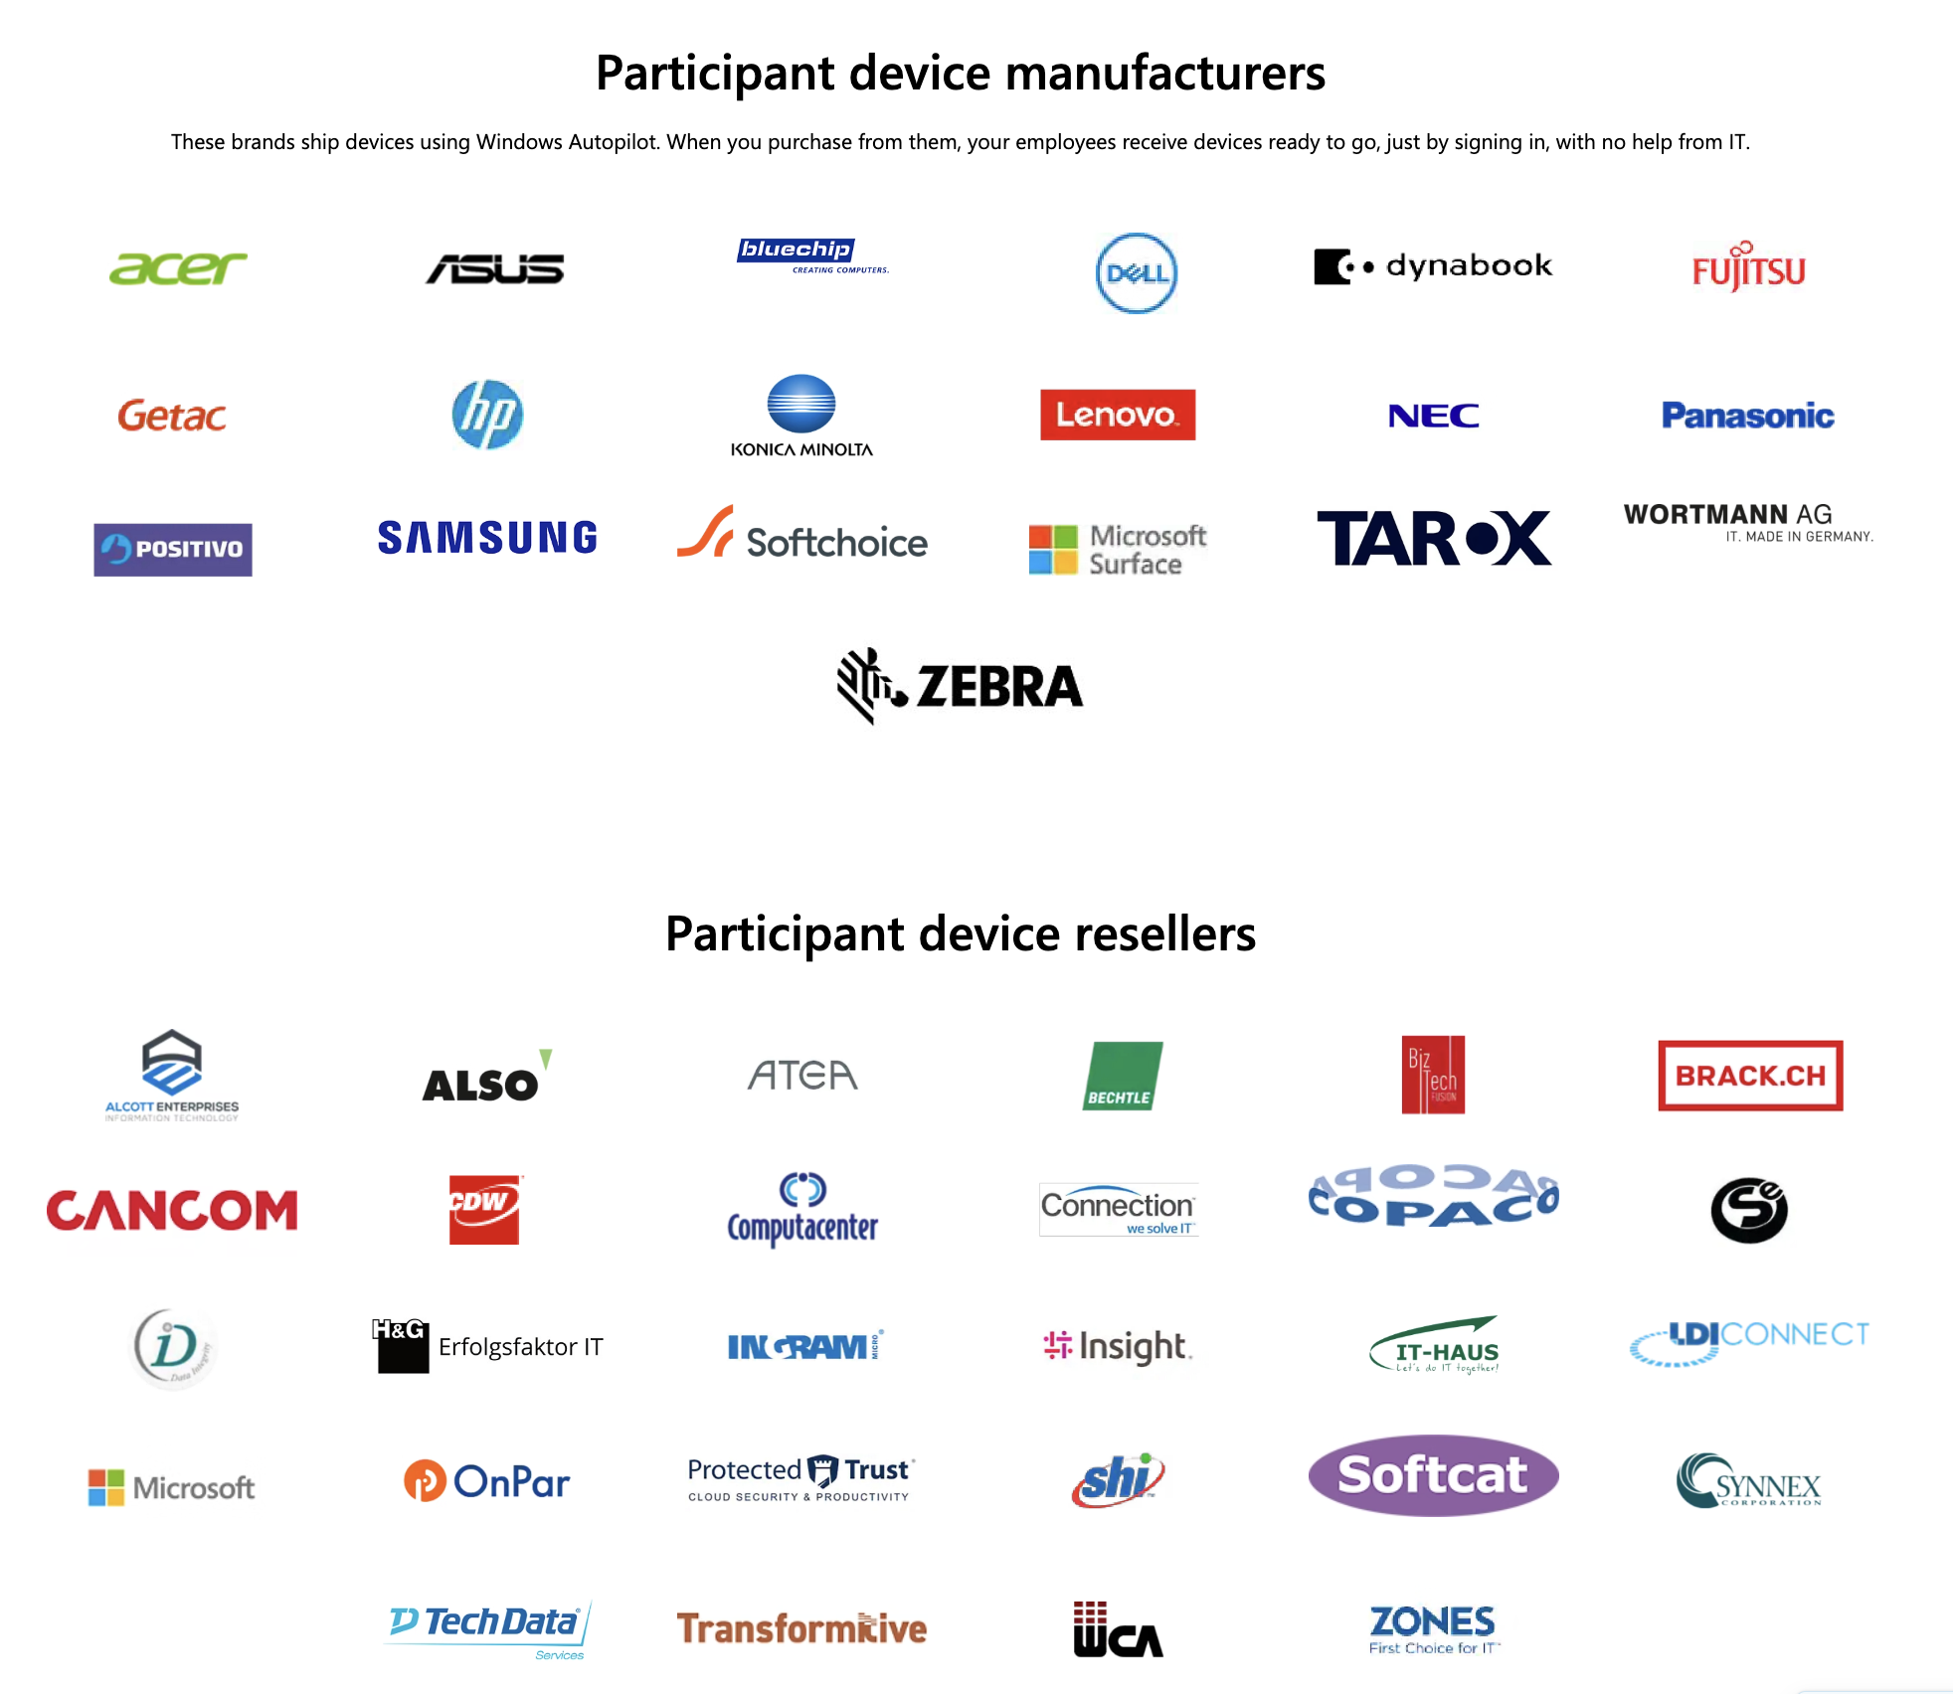
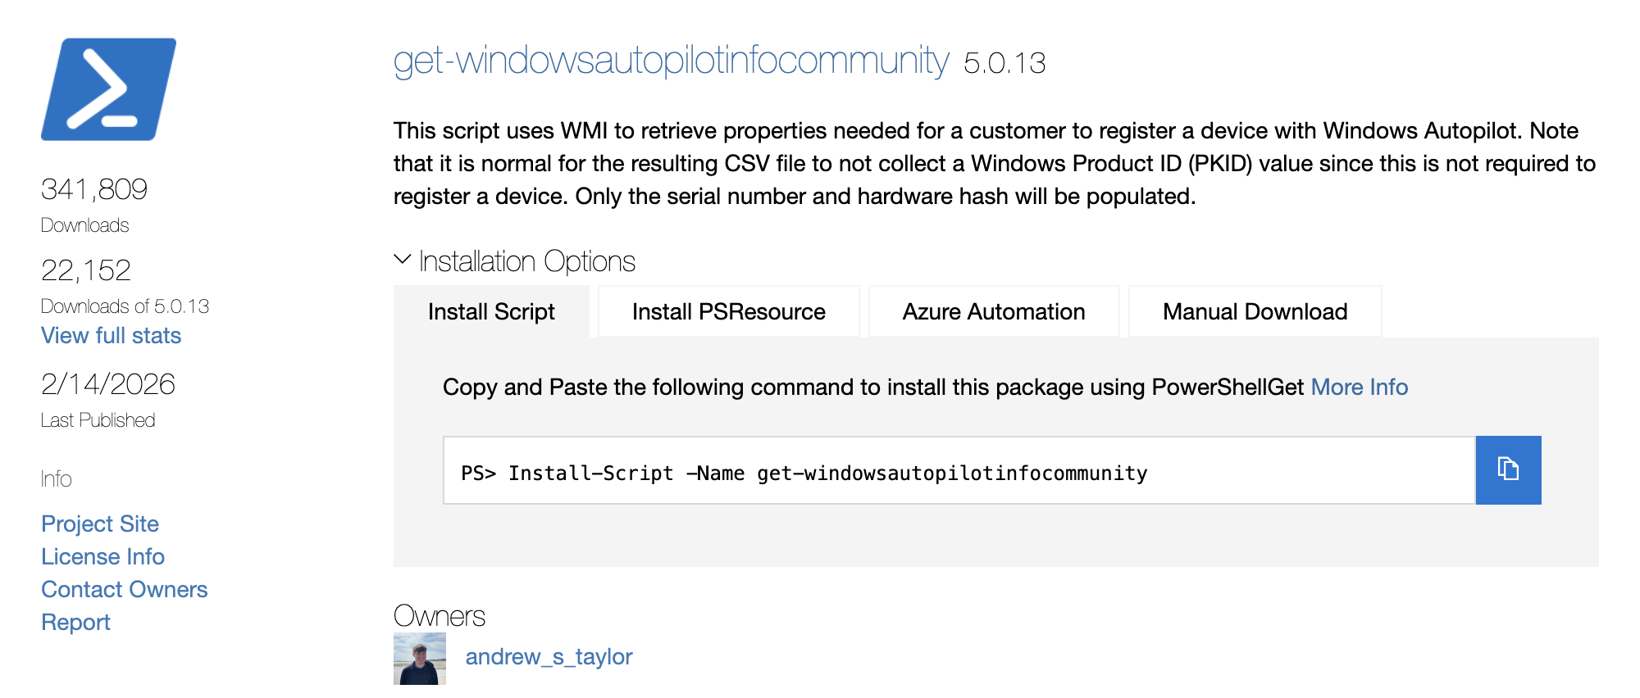
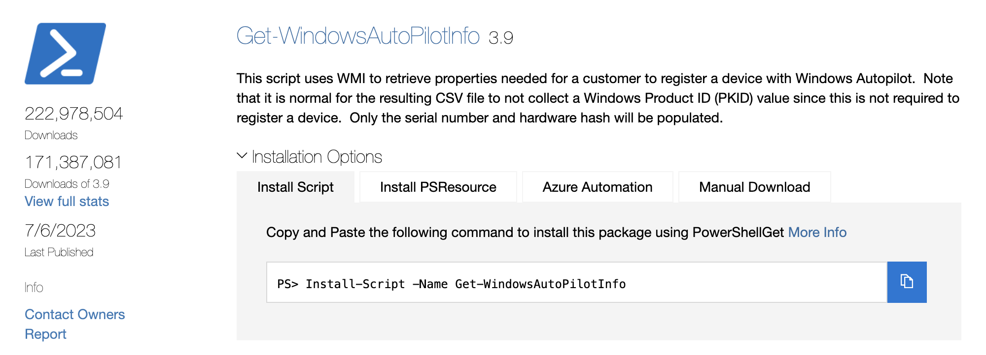

Slide 7
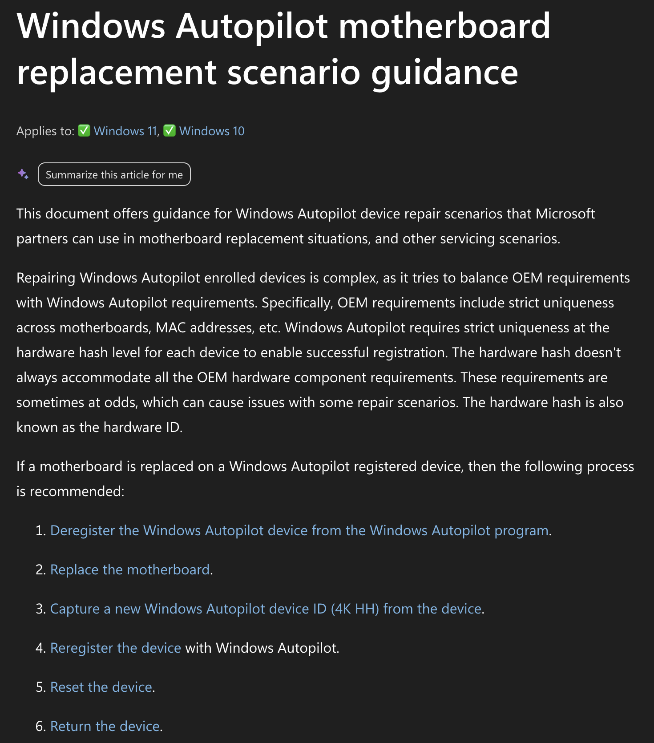
Apple makes it look easy, but:
  Apple has only one OEM, itself, manufacturing and repairing all devices
  PC supply chains are complicated: resale, refurbishments, returns, leases
  How do you prove you own something?

Slide 8
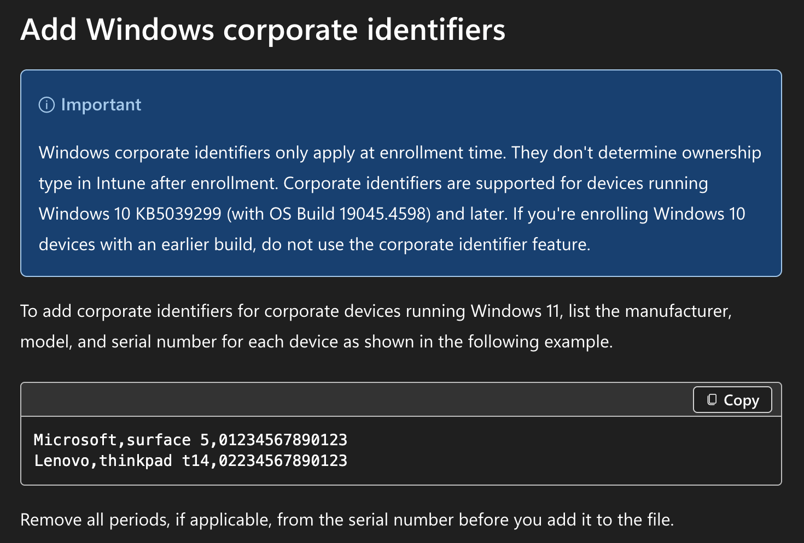
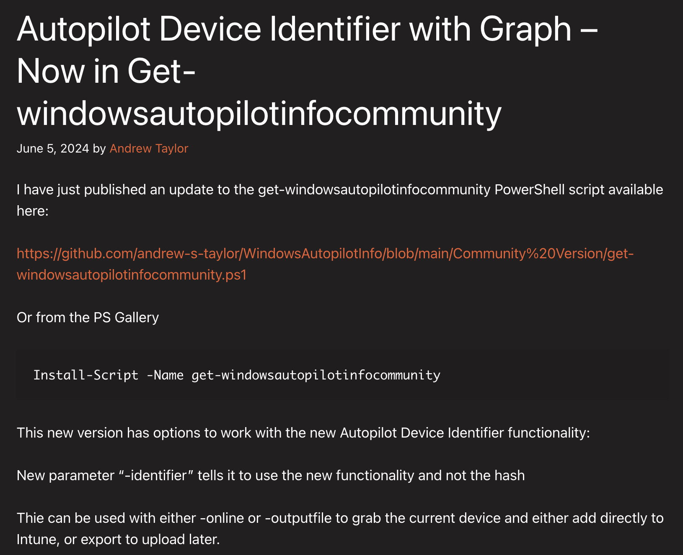

Slide 9
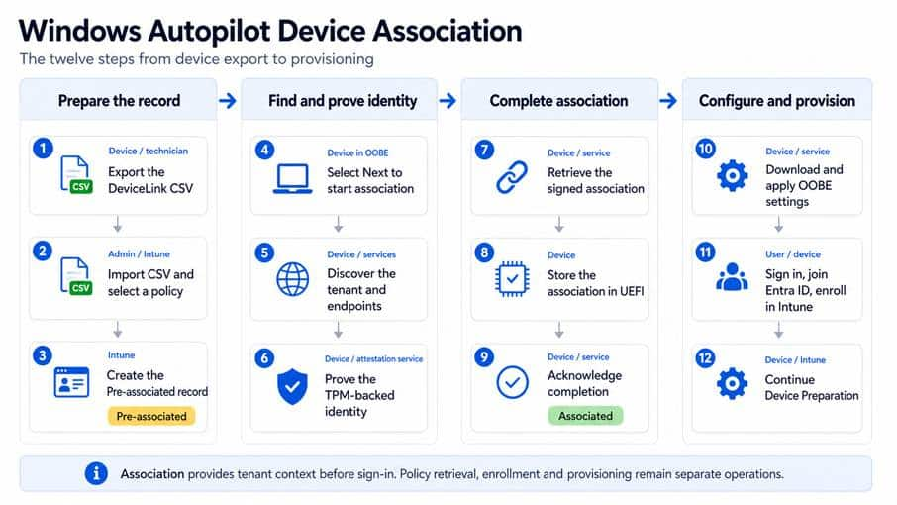
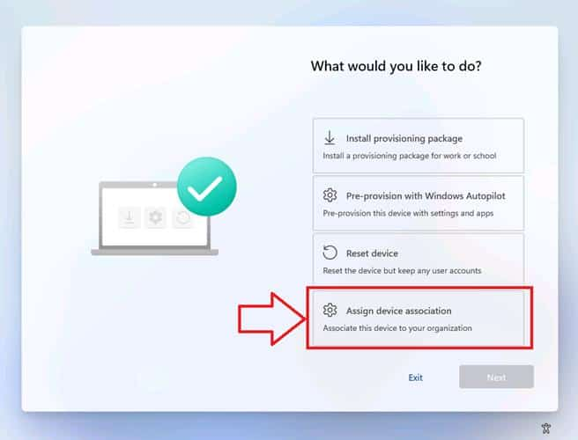
https://patchmypc.com/blog/windows-autopilot-device-association/

Slide 10
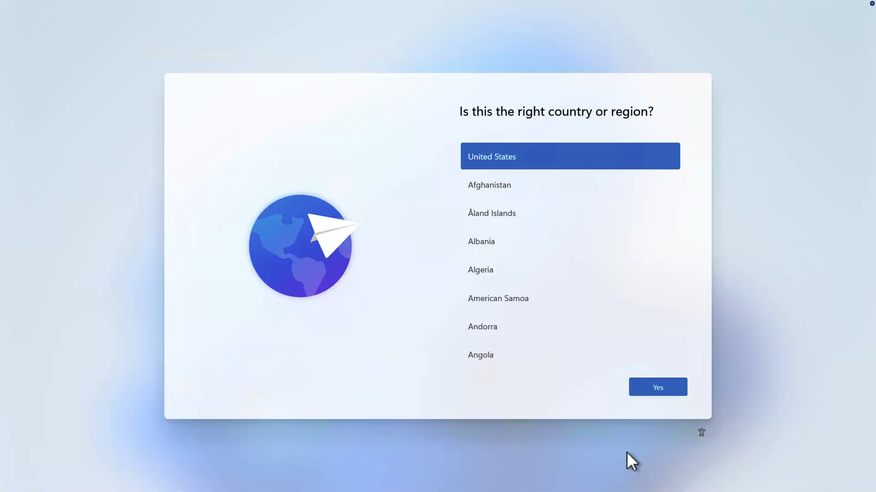

Slide 11
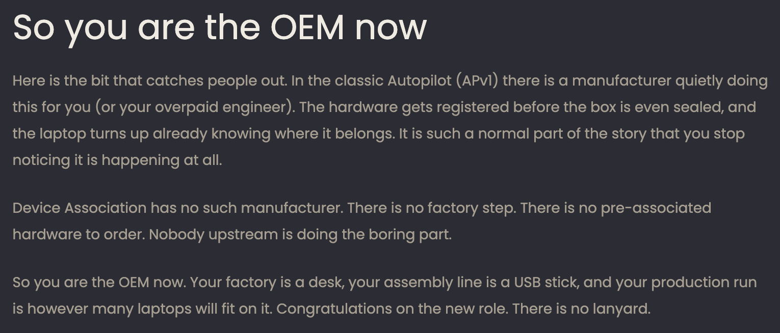
Windows Autopilot Device Association
Windows Autopilot Device Association: somebody has to be the OEM

Slide 12
#2: User-driven scenario should focus on the user (duh)

Slide 13
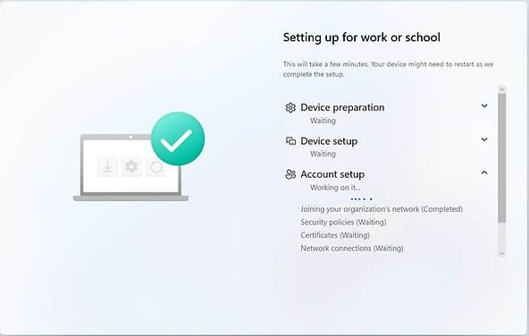
  Users want to know:
    When will this be done?
  IT admins want to know:
    What is happening now?

Slide 14
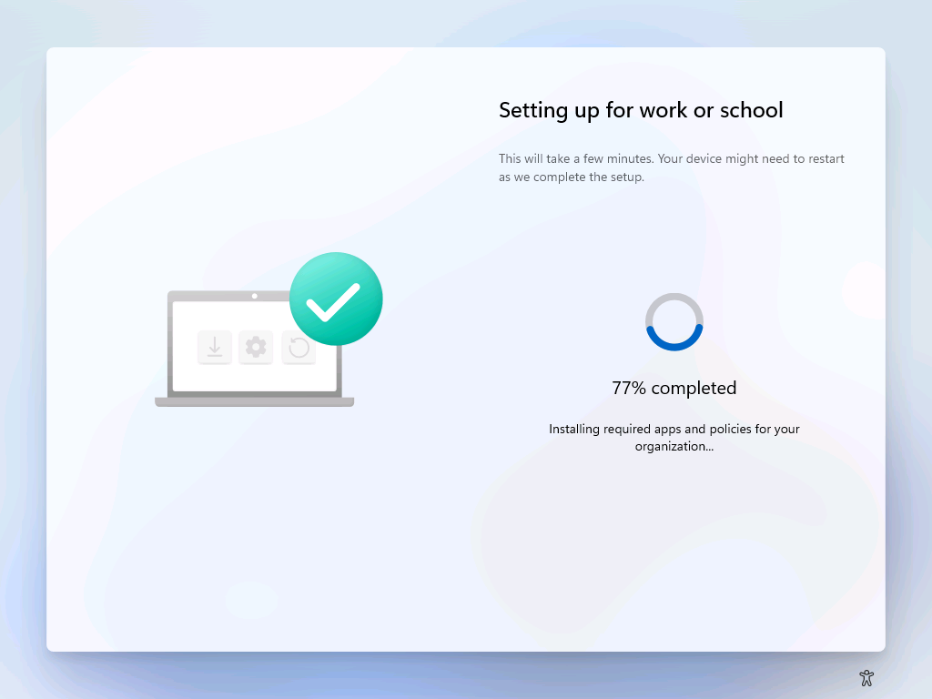
  Users want to know:
    When will this be done?
  IT admins want to know:
    What is happening now?

Slide 15
#3: “Soon” is not an exact term

Slide 16
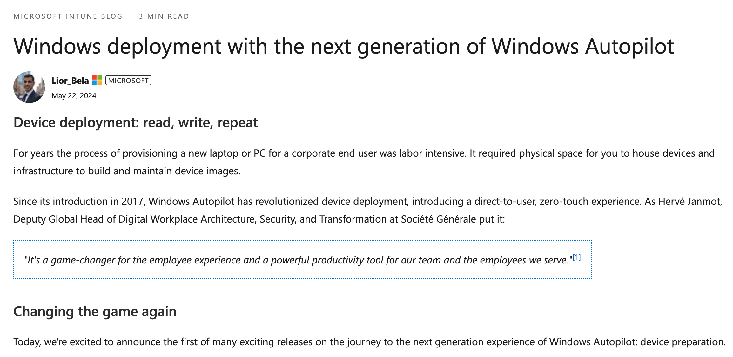
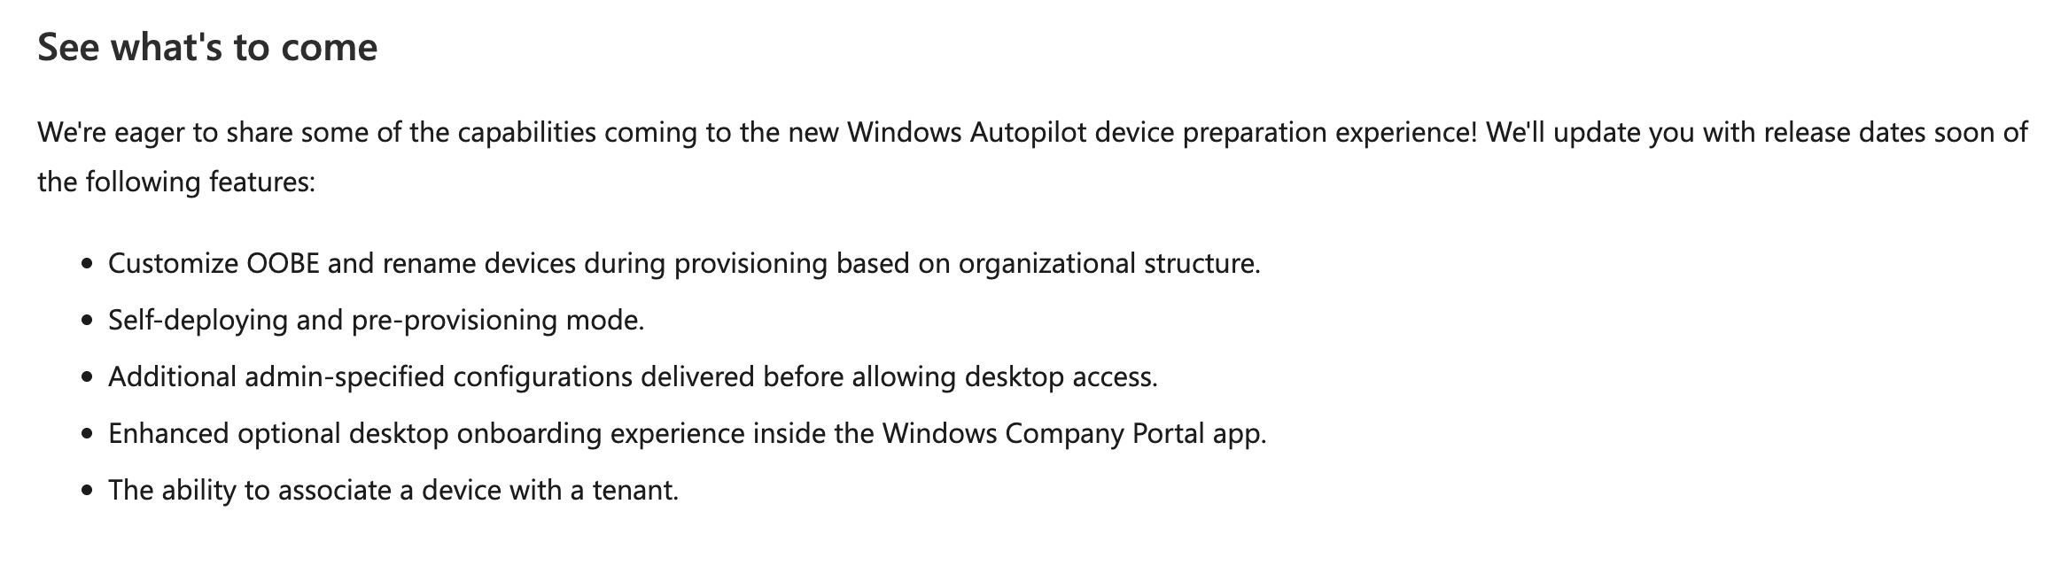

Slide 17
#4: Apps, ugh

Slide 18
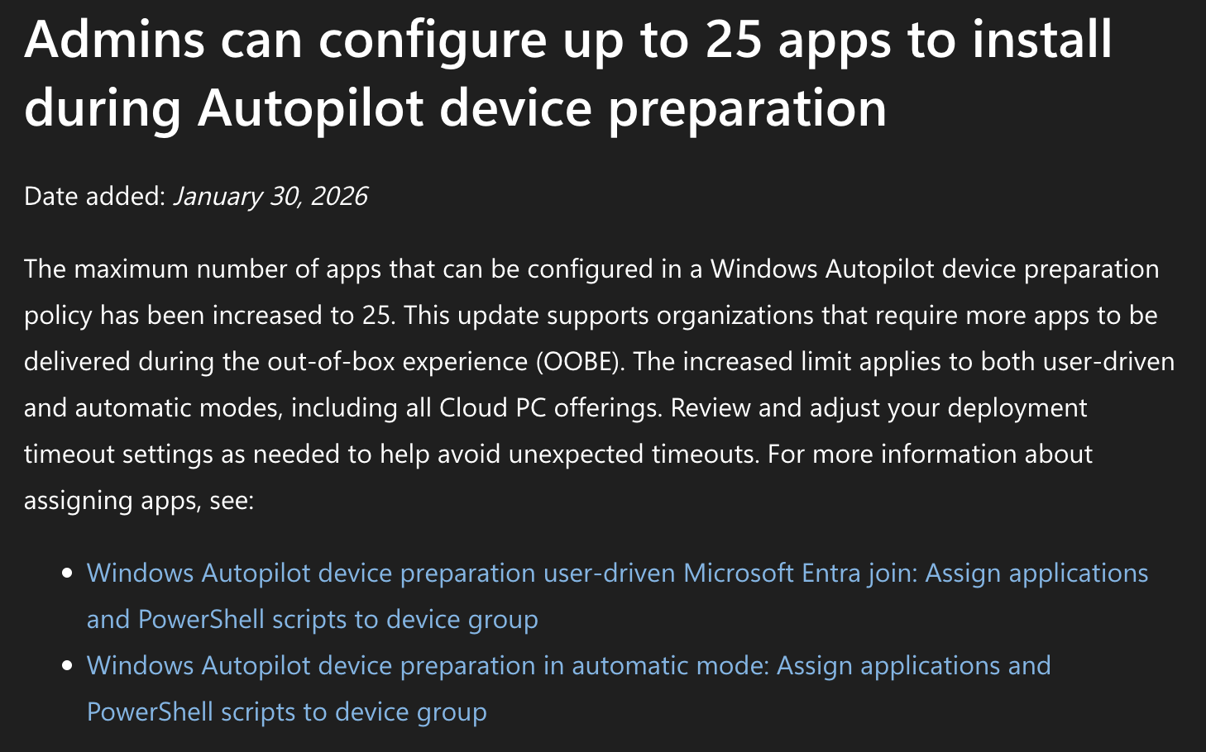
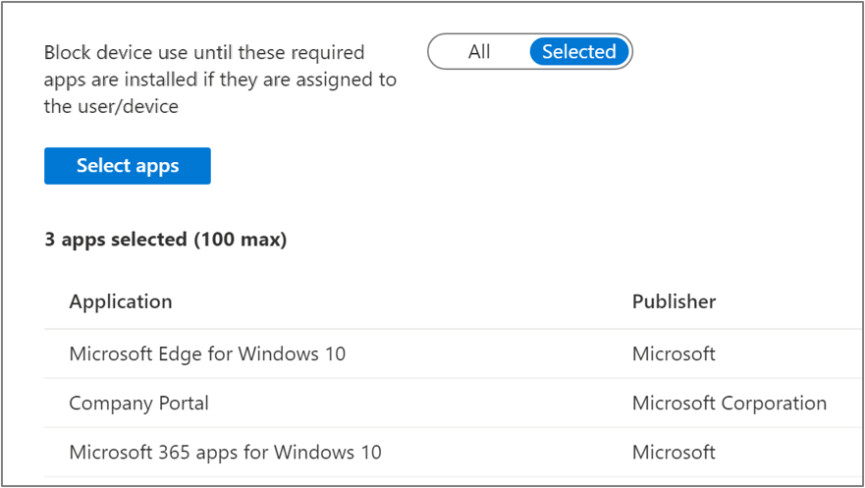


Slide 19
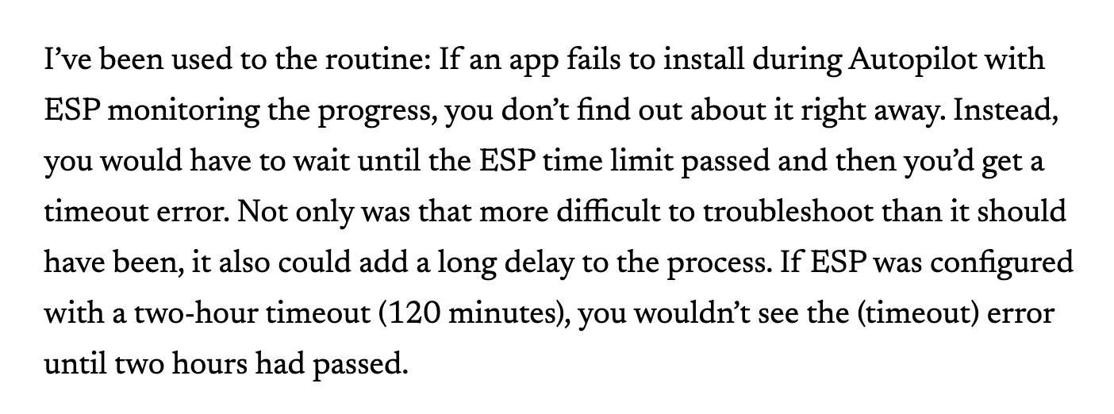
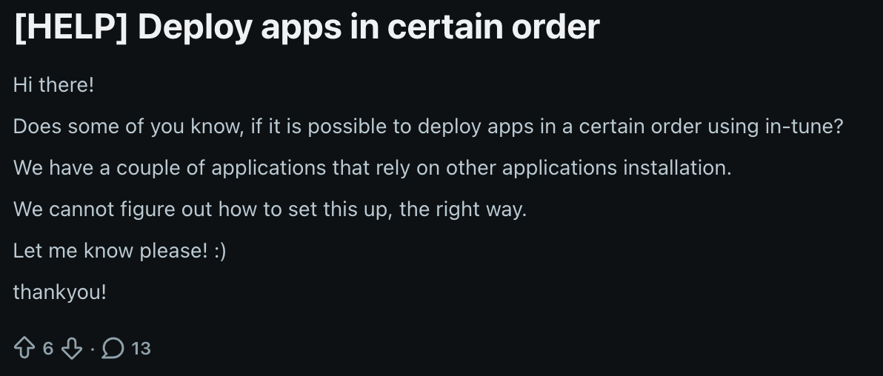
Fixed in 2024
Would make people really happy…

Slide 20
#5: Policies, ugh

Slide 21
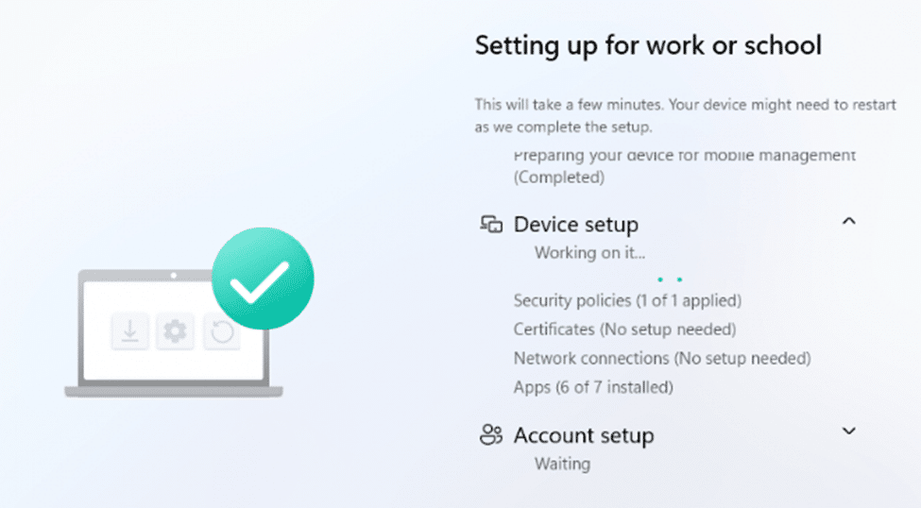
  Did you ever wonder?

Slide 22
#6: Windows vs. Intune

Slide 23
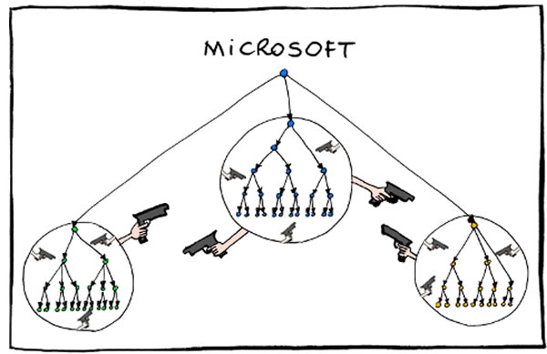
Windows vs. Intune vs. AAD
Intune absorbs Autopilot and Windows Enterprise (kind of)

Slide 24
#7: Performance is great when you don't test with a real MDM…

Slide 25
#8: Designed for "ludicrous scale" when not needed

Slide 26
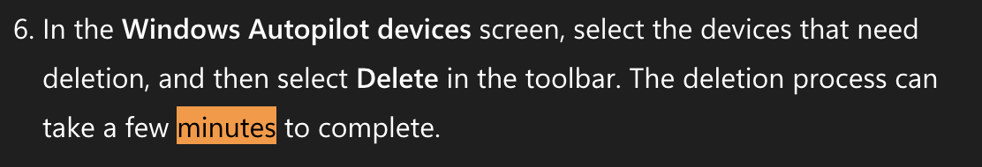
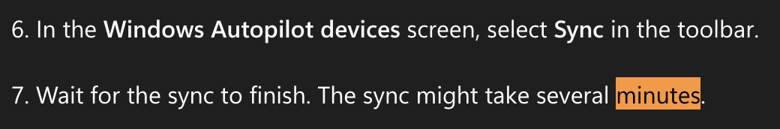
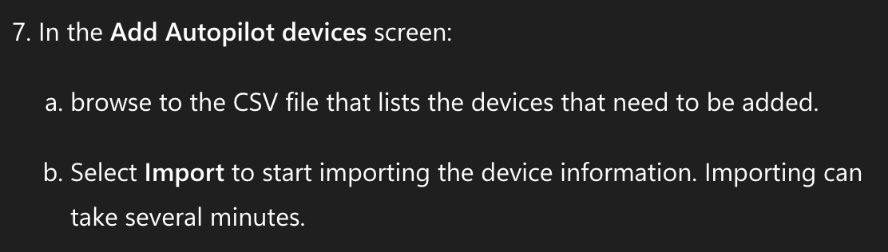

Slide 27
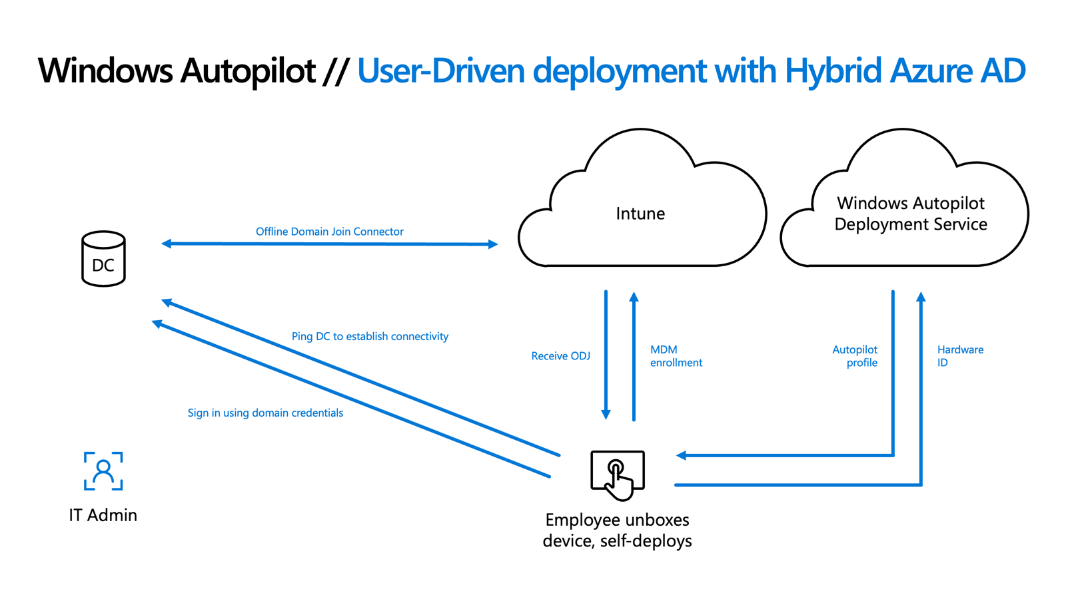

Slide 28
#9: Hybrid was doomed from the start

Slide 29
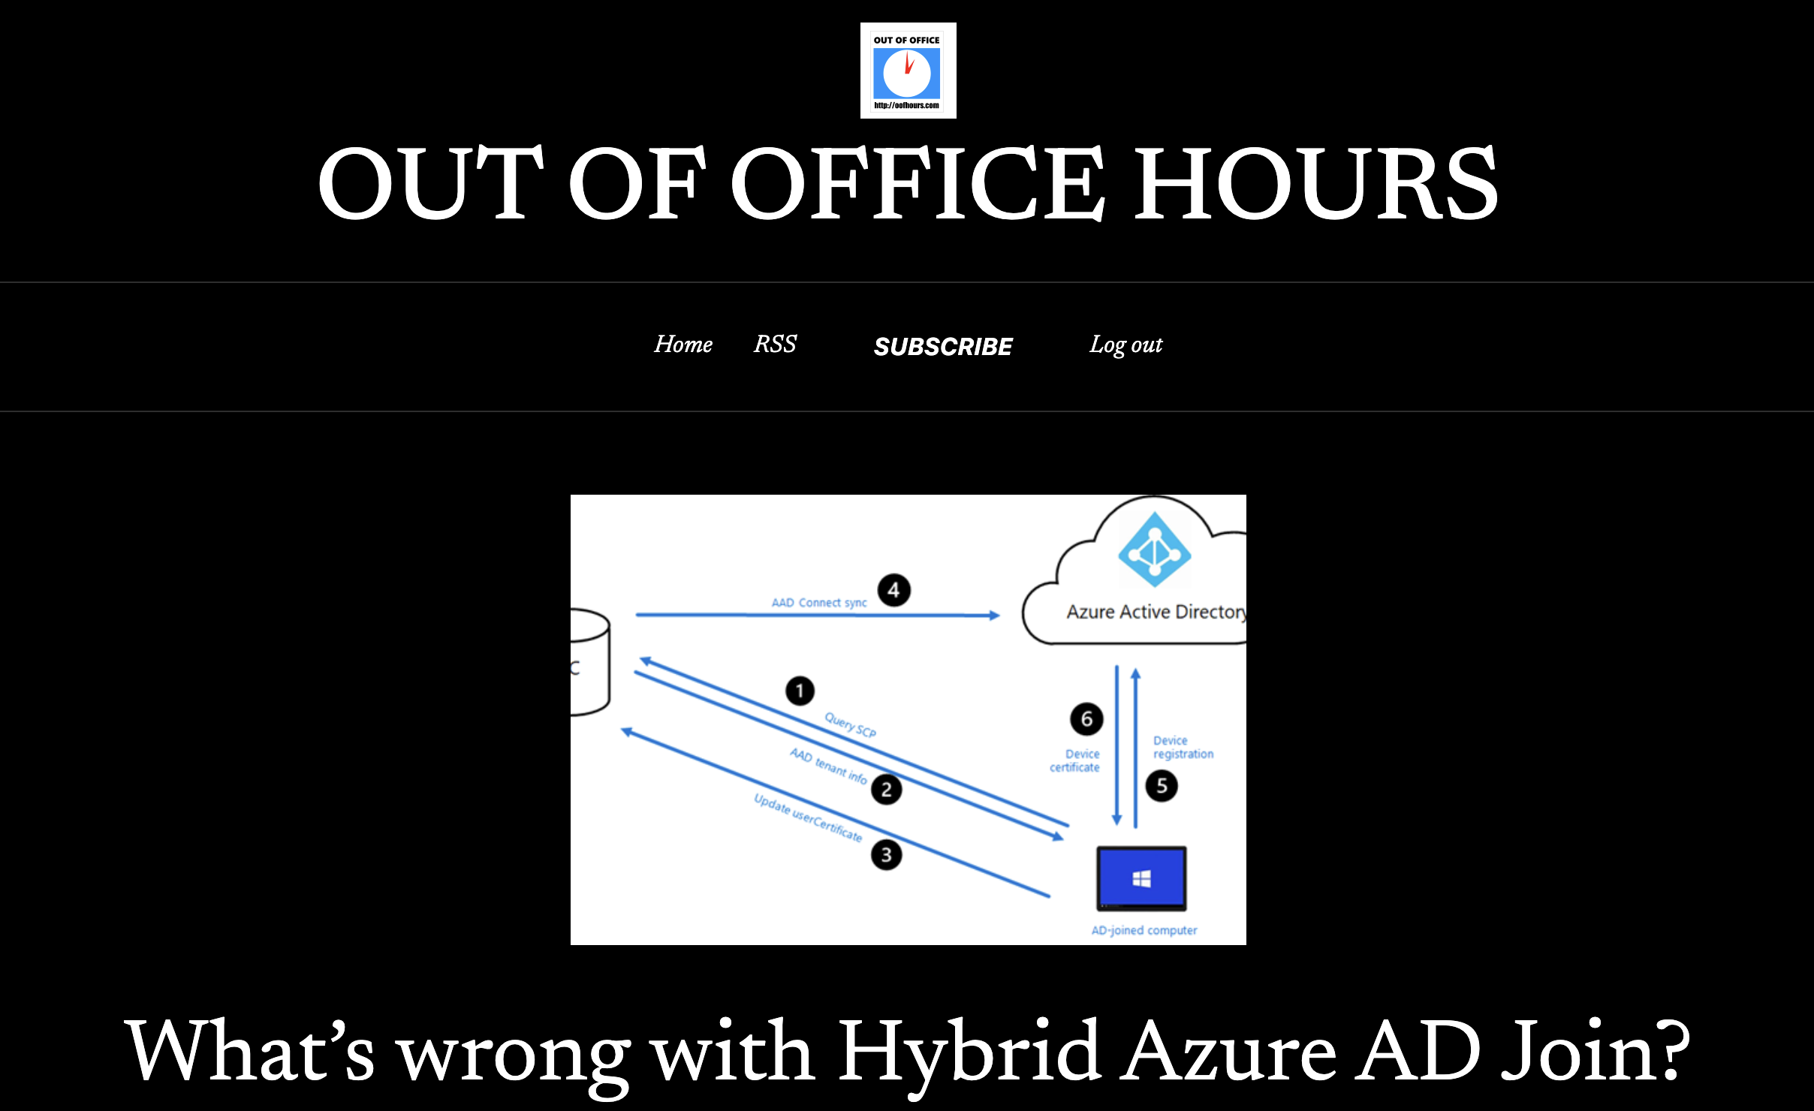
RIP, ADFS; hello AAD Connect
DirectAccess is dead, long live DirectAccess
Just switch to Always On VPN. Wait, you want to use a different VPN?
PC names don’t matter (and are apparently case-sensitive?)
You only want to target a single device?
Push customers to the cloud, meet them where they are, push them to the cloud, meet them where they are…
Stay on the bridge, blow up the bridge

Slide 30

Implement Always On VPN or a third-party equivalent that supports automatic connections
Check the “Skip AD Connectivity Check” box in the HAADJ Autopilot profile
Turn off user ESP. See the “SkipUserStatusPage” instructions in my post here. (There really should be a checkbox in the ESP settings to make this easier.)
Target your Domain Join profile to “All devices.”
Specify the {{FullyQualifiedDomainName}} attribute on certificate templates in Intune
(Optional) Rename the AD device after the provisioning process completes. See this post for the details around that (AD/VPN connectivity required)
No kittens were harmed during the creation of this slide, or during any HAADJ provisioning process for that matter

Slide 31
#10: Troubleshooting, why do we need troubleshooting?

Slide 32
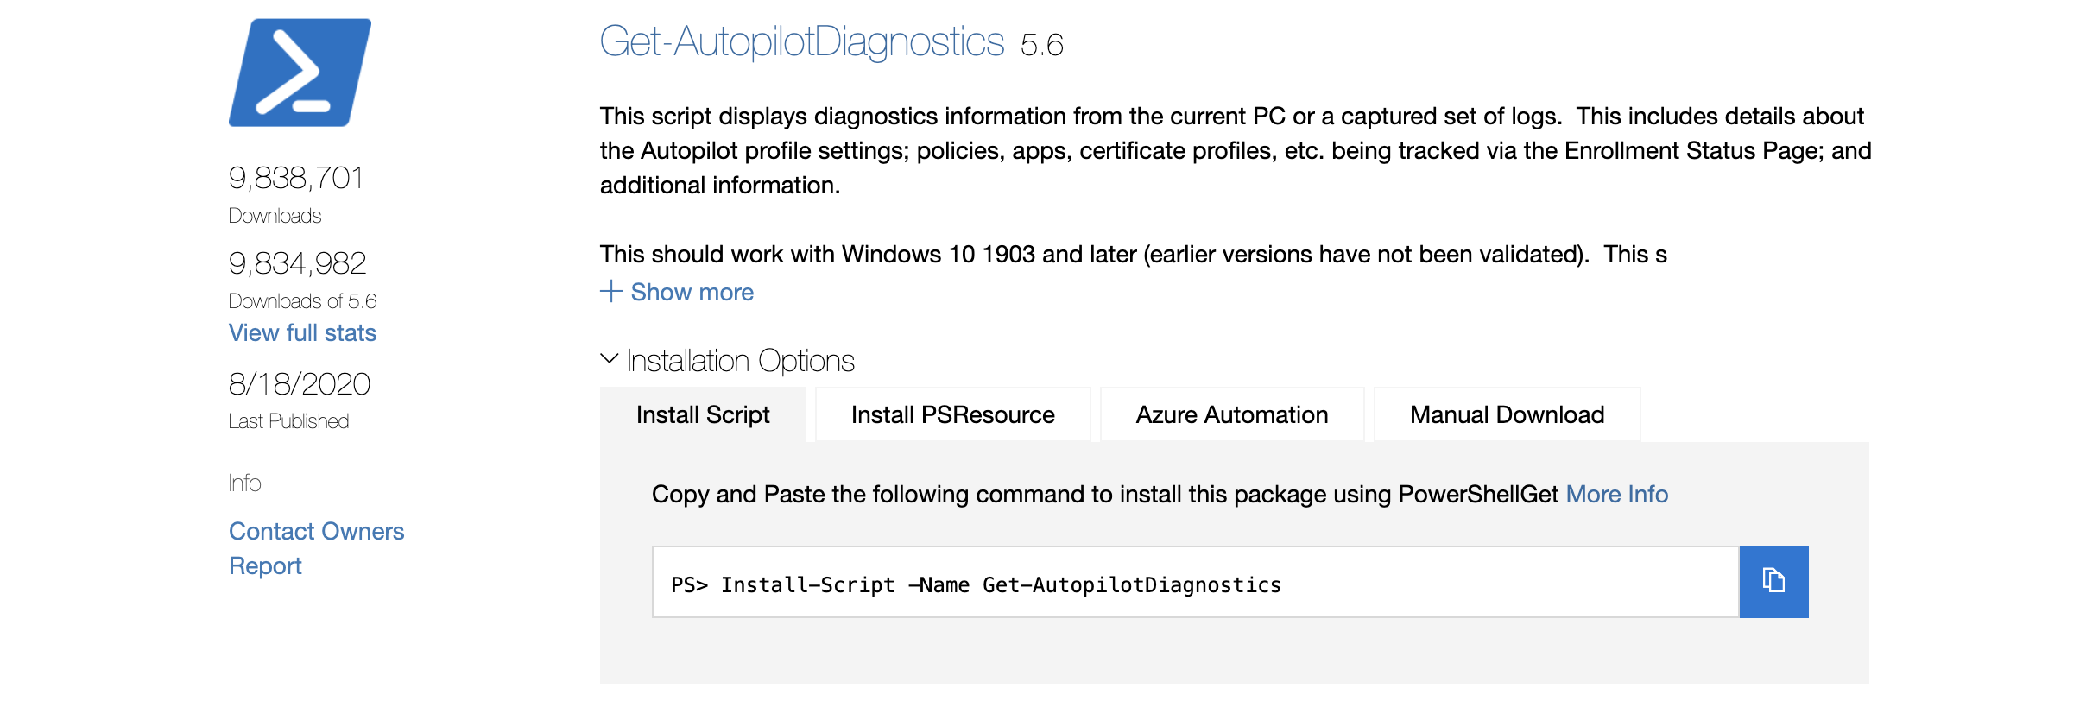
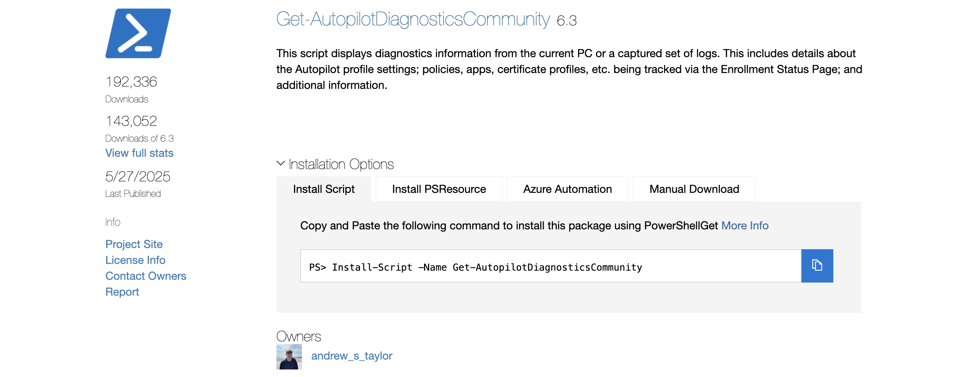

Slide 33
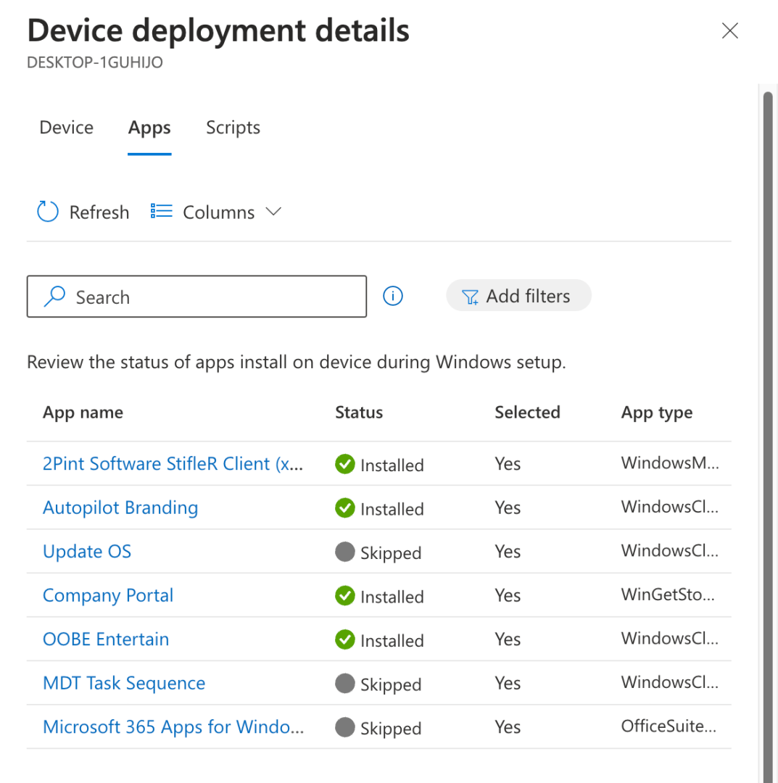
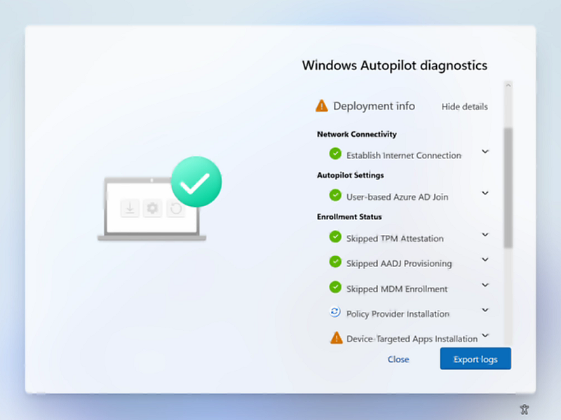
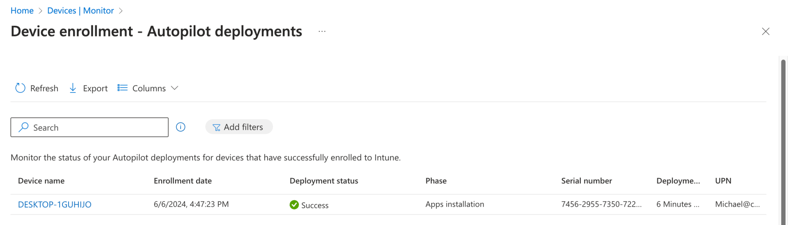

Slide 34
#11: “All you need is Autopilot”…
Don’t let reality get in the way of perfectly good marketing…

Slide 35
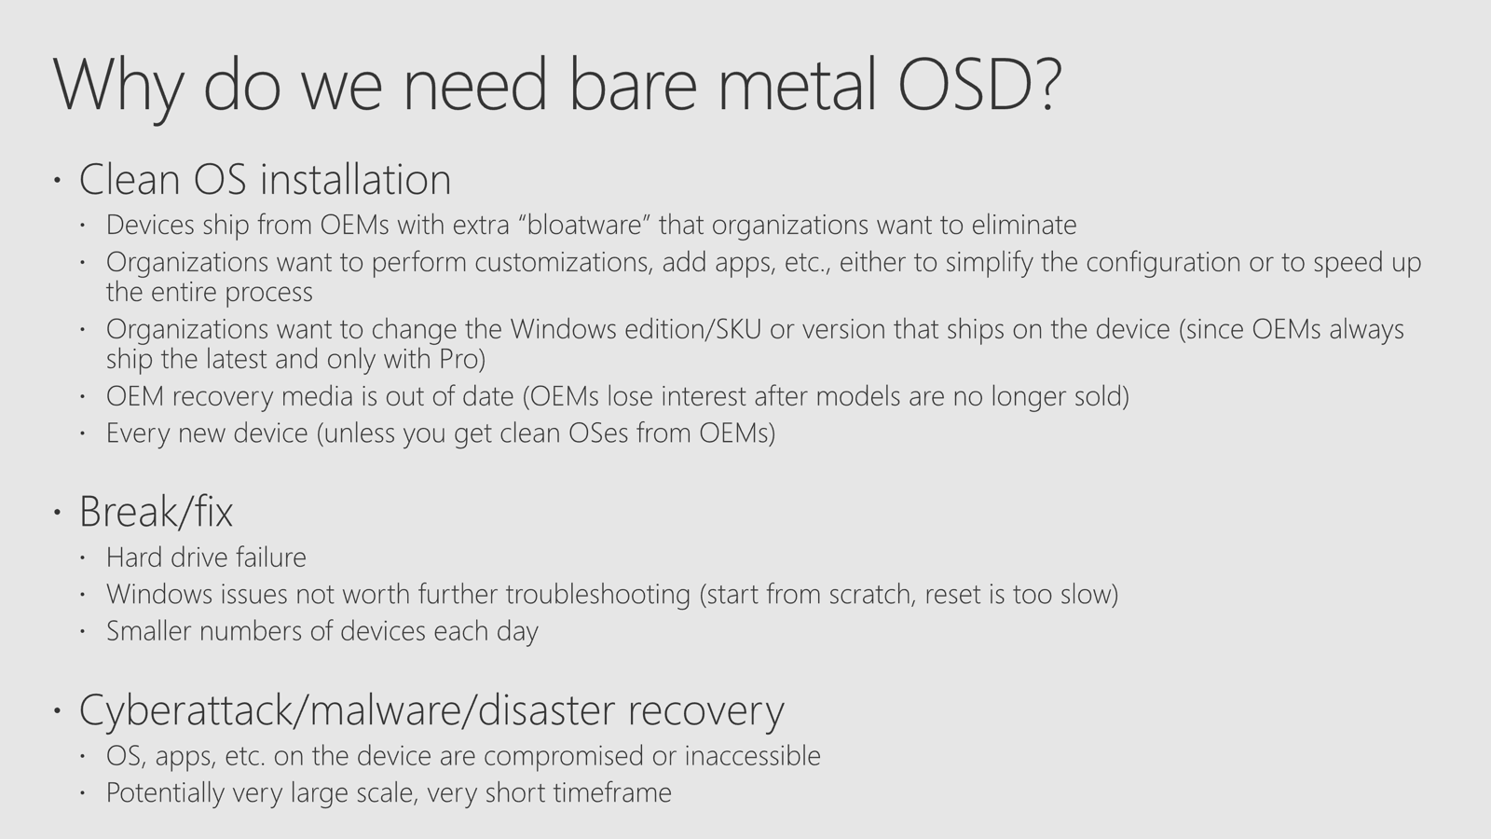
Imaging != Provisioning

